Slide 1
The Sky’s the Limit UAV Drones and their Applications
November 26, 2015
Clark Commons

Slide 2
Welcome & Introduction
Dr. Danny Silver
Director

Slide 3
W5 on AIDA
What:
An institute, not a research group
Who:
Danny Silver, Director
Lisa Speigel, out-going Comm. & Events Coordinator
Audrey Kruisselbrink, new Comm. & Events Coordinator
Where:
4th Floor Patterson Hall, Acadia University
When:
Since January, 2014

Slide 4
Why: AIDA’s Mission
To advance knowledge in data analytics through:
Collaborative and interdisciplinary research
Application and commercialization
Education and training
Promotion and outreach
To foster the ethical application and commercialization of data analytic solutions to challenges facing industry, government and society in rural Canada.
Foci: Agriculture, Agri-food, Environment, Green Energy, Health Care.

Slide 5
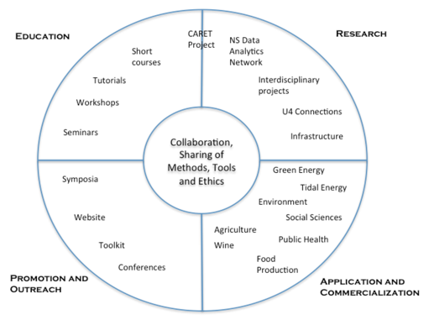
AIDA’s Mission
Initial foci:
Agriculture
Agri-Food
Environment
Green energy
Health care

Slide 6
AIDA Objectives
Promotion and Outreach: To provide visibility for data analytics initiatives undertaken by members and communicate relevant events to industry, government and the public. To make the institute relevant to rural business and industry. To foster sharing of knowledge and use of data analytics through vehicles such as web inventories of member competencies and resources.
Research: To encourage, facilitate and leverage fundamental and interdisciplinary research and to attract high quality visiting scholars. To work with members to provide shared technical infrastructure for research and development where possible.
Education: To facilitate the development and delivery of educational programs such as short courses, training workshops, and seminars that are focused on the needs of members.
Application and Commercialization: To foster the development of innovative applications for use in academia, industry and government. To establish Nova Scotia as a leader in the application of data analytics to rural problems. To stimulate technology transfer, commercialization and the development of new startups.

Slide 7
Purpose of Seminar
Highlight:
Current state of UAV technology
Current application areas and future possibilities
Open problems for researchers and practitioners
Identify the value and importance of developing UAV technology and expertise in Atlantic Canada
Encourage interest in the application of this technology

Slide 8
Schedule
12:00 Lunch/Networking
12:30 Take Off - Welcome/Introduction
Climb and Level Out: Keynote Speaker
12:45 Stewart Baillie – Drones: A nearly 100 year Technology Revolution
1:45 Refreshments/Networking
Dive Down: Short Talks
2:15 Patrick Edwards-Daugherty - Pleiades
2:25 Richard van der Put – Skysquirrel
2:35 John Frost - Aerhyve
2:55 David Fraser – McInnes Copper - UAVs and Privacy
3:15 Refreshments/Networking
Approach & Landing: Group Think and Share
3:30 Group Discussion and Reporting
4:30 Farewell

Slide 9
Climb and Level Out Key Note Address

Slide 10
Keynote Speaker
Mr. Stewart Baillie
Past Chair,
Unmanned Systems Canada
30 years experience:
Aviation flight testing,
Research,
Management,
Director of the NRC Flight Research Laboratory
Drones - A Nearly 100 Year Technology Revolution

Slide 11
Coffee & Connections
RESEARCH
PROBLEMS

Slide 12
Dive Down Short Talks

Slide 13
Patrick Edwards-Daughtery
Grew up in Halifax
Studied theoretical physics at
McGill and Cambridge Universities
Founded Pleiades in 1999, Halifax
Create Spiri - a micro-UAV, in 2012
KickStarter project
Fully programmable, autonomous, quadcopter robot

Slide 14
Richard van der Put
MSc, Eindhoven Univ. of Technology
9 years of scientific research experience
Image analysis algorithms for health care and robotics
Co-founder & CTO SkySquirrel Technologies Inc.

Slide 15
John Frost
President and CEO of Frostbyte Interactive Inc. and Aerhyve Aerial Technologies
A cross-cultural specialist in technology adaptation
Aerhyve’s focus:
Analysis of UAV data with Machine Learning methods
Actionable intelligence for agricultural and industrial applications

Slide 16
David Fraser
LLB, Law, Dalhousie
Partner at McInnes Cooper
Leader in internet, technology and privacy law
Author of the popular Canadian Privacy Law Blog and Canadian Cloud Law Blog
Past President of the Canadian IT Law Association
2009, Canada’s “Top 40 Lawyers Under 40” by Lexpert
Avid UAV videographer, well known for his aerial videos of Nova Scotia
UAVs and Privacy: The legal landscape for aerial cameras and sensors

Slide 17
Coffee & Connections
RESEARCH
PROBLEMS

Slide 18
Approach and Landing Group THINK & SHARE

Slide 19
Group Think & Share
Questions for table discussions:
What are the major UAV technical challenges/opportunities over the next 3 years?What are the major UAV business challenges/opportunities over the next 3 years?
What are the most significant growth areas in UAV application in the next 3 years?
What advice do you have for new start-ups in the UAV space? What advice do you have for companies considering the use of UAVs to solve a business problem?
What direction/changes do you feel regulation and the law should take on UAVs in Canada?
What is most needed to stimulate the UAV sector in Maritime Canada?

Slide 20
Summary and Close
Thnk you to our sponsors
Thank you to all our speakers
Thank you to all participatants
Got a problem to which you feel data analytics can be applied?
Let us know ➔ aida.acadiau.ca

Slide 21
Exchange Contact Info
RESEARCH
PROBLEMS

Slide 22
Extra Images

